Slide 1
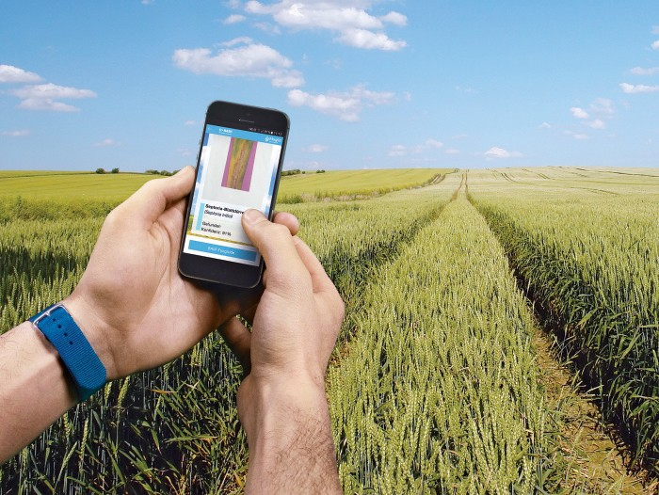
GreenHarvest - A Digital Bridge For Farming
INFO5100 – Application Engineering and Development
Spring 2025
Rudra Patel – 002025285

Slide 2
Outline
Problem Statement
Solution
Stakeholders
Key Functionalities
High-Level System Architecture
UML Diagram
Functional Flow

Slide 3
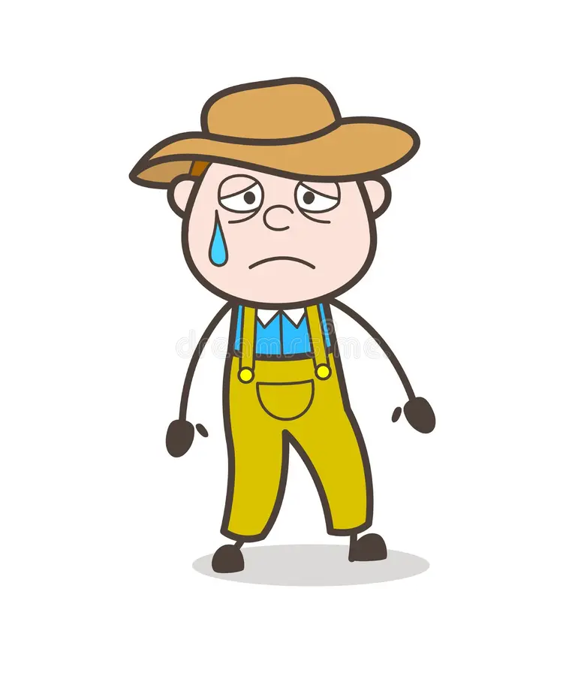
Problem Statement
Lack of unified support system: Small farmers struggle due to limited access to expert guidance, organic certification, and direct market reach.
Customer trust issues: Consumers are hesitant to buy organic products without transparent proof of authenticity and certification.
Need for a collaborative platform: There's a strong need for an integrated system that connects farmers, experts, government, and consumers to streamline organic farming and boost trust.

Slide 4
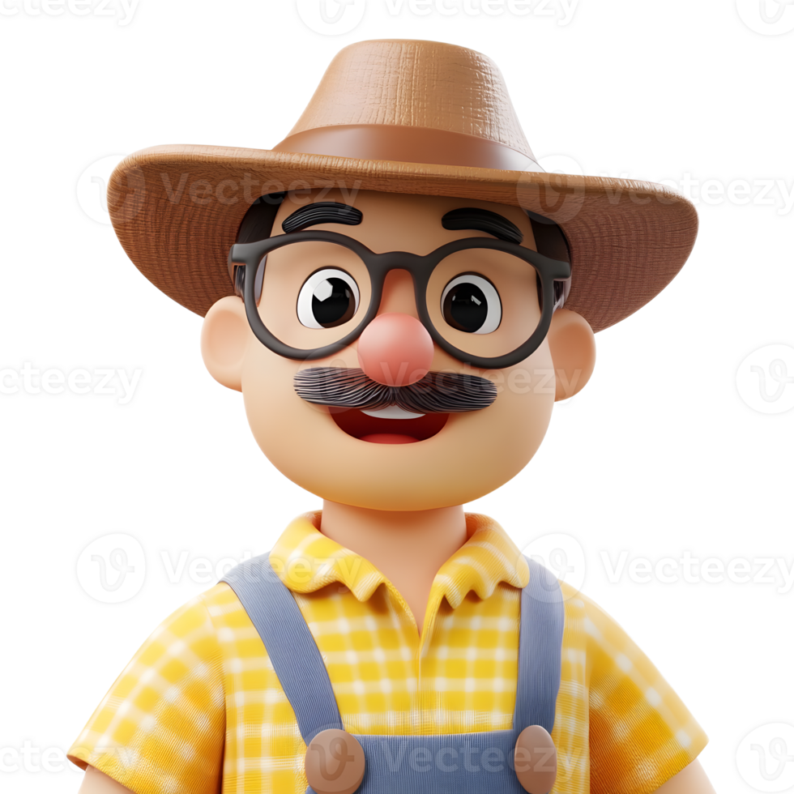
Solution
🌱 GreenHarvest bridges the organic ecosystem by digitally connecting farmers, customers, experts, government officers, doctors, and distributors on a unified Java-based platform.
📦 Empowers farmers with end-to-end support—from expert validation, subsidy applications, and health assistance to direct sales and coordinated logistics.
✅ Ensures customer trust and transparency by offering only certified organic products backed by expert workflows, traceable delivery, and health-conscious practices.

Slide 5
Stakeholders
Farmers – Grow crops, apply for certification, request subsidies and health support, sell products
Experts – Review organic certification requests, provide farming advice
Government Officers – Approve subsidies, organize training and educational events
Doctors – Provide medical advice and support to farmers
Distributors – Manage product pickup and delivery logistics
Customers – Purchase certified organic products directly from farmers

Slide 6

Key Functionalities
✅ Get crops certified by experts for organic approval
🛒 Sell directly to customers through a trusted marketplace
👨‍⚕️ Request medical help and get doctor advice
🧾 Apply for subsidies from government officers
🎓 Join training events to learn better farming methods
📦 Coordinate delivery with assigned distributors
💬 Ask questions and get expert farming advice

Slide 7
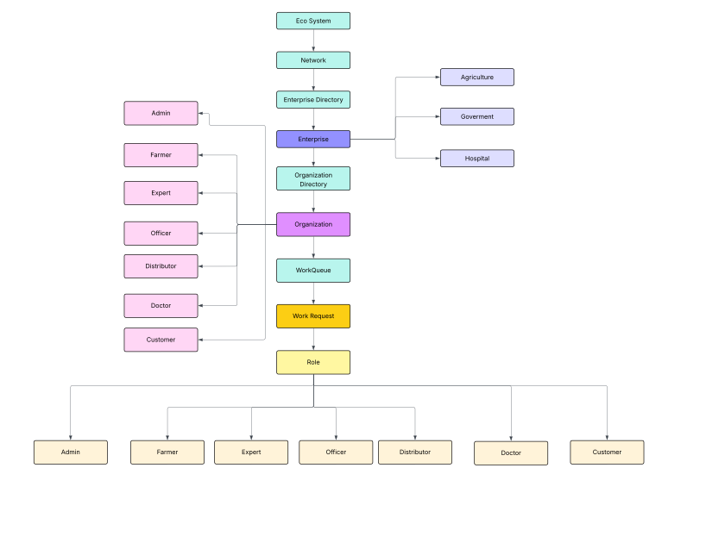
High-Level System Architecture

Slide 8
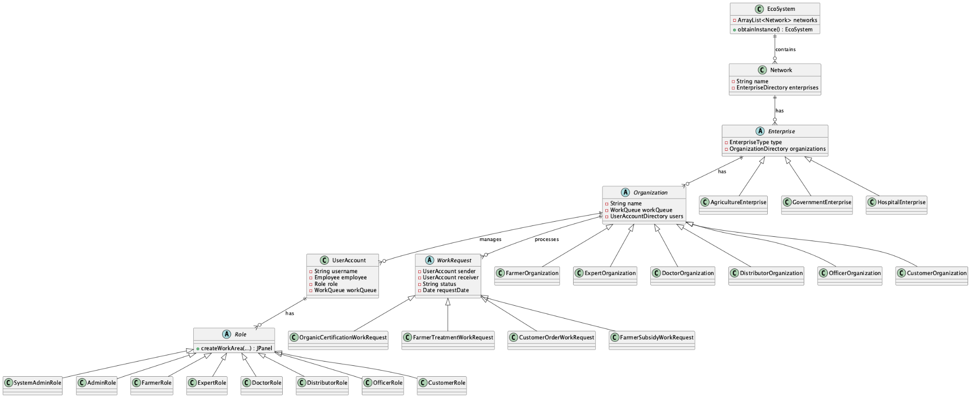
UML Diagram

Slide 9

Functional Flow
Farmer requests certification → Expert reviews and approves
Product is listed → Customer places an order
Order confirmed → Distributor picks up from farmer
Delivery completed → Customer receives certified product
Farmer feels unwell → Sends health request → Doctor reviews and provides treatment advice
Farmer applies for subsidy or training → Officer reviews request or publishes events
Training event published → Farmers view and register

Slide 10


